Slide 1
Capstone Project – The Battle of Neighborhoods
© JG 2021

Slide 2
Outline
Introduction
Business Problem and Interest
Libraries and Modules
Data
Methodology
Data Analysis
Results
Discussion
Conclusion

Slide 3
Introduction
California's second largest city and the United States’ eighth largest, San Diego boasts a citywide population of nearly 1.3 million residents and more than 3 million residents countywide.
San Diego is renowned for its idyllic climate, 70 miles of pristine beaches and a dazzling array of world-class family attractions including the world-famous San Diego Zoo and San Diego Zoo Safari Park, SeaWorld San Diego, and LEGOLAND California.
The sunny weather makes San Diego a hot spot for vacationers of all ages from around the world.
The city is not only about tourism and beach holidays, but also a good destination for plenty of qualified employees and entrepreneurs to start a business.
In terms of economy, San Diego, having GDP of over $250 million, made it to the top 20 major cities in the United States.
Business owners often consider San Diego city as a good destination for moving and expanding their business because of housing and low cost of doing business as compared to Los Angeles and San Francisco areas.
The objective of the project is to find a right location for opening up an Italian restaurant in San Diego.

Slide 4
Business Problem and Interest
Business Problem:
As San Diego receives people from all around the world, and people love to try new food, we will try to find an adequate location for opening up an Italian Restaurant in San Diego.
Finding a proper location for a restaurant is crucial for business success. Hence, to select the right location for the restaurant, we will consider following elements:
Know the neighborhood, specifically, who else is doing business in the neighborhood
Find a place which is not crowded with similar restaurants in vicinity
Accessibility and visibility of the location
Population base to know the foot traffic or car traffic in the area to support the business
Parking for the customers, and
Low crime rate in the area as high crime rates can make potential customers uncomfortable to visit the restaurant due to fears over public safety.
Our objective is to discover a few most promising neighborhoods based on above-mentioned criteria using data science skills, and present them with statistics so that the stakeholders can select the precise location for their restaurant.
Interest:
Our target stakeholders are the restaurant entrepreneurs who would be interested in starting a restaurant in San Diego, California

Slide 5
Libraries and Modules
Libraries and Modules | Description | Doc Link | Installation Link
Numpy | Python Library to handle data in a vectorized manner | Doc | Installation
Pandas | Python Library for data analysis | Doc | Installation
Json | Python Library to handle json data | Doc | Installation
Requests | Python Library to handle URL requests | Doc | Installation
Scikit-learn | Python Machine learning library | Doc | Installation
Folium | Python Map rendering library | Doc | Installation
Geopy | Python Library to locate the coordinates of addresses | Doc | Installation
Plotly | Python Plotting library | Doc | Installation
Matplotlib.cm | Python Plotting library for colormap handling | Doc | Installation
Matplotlib.colors | Python Plotting library for colormap visualization | Doc | Installation
Matplotlib.pyplot | Python Plotting library | Doc | Installation
Matplotlib.image | Python library for image plotting | Doc | Installation

Slide 6
Data
San Diego neighborhoods data has been collected from Wikipedia uisng BeautifulSoup library and processed the data in order to use this in this project.
https://en.wikipedia.org/wiki/Template:Neighborhoods_of_San_Diego
2. The geographical coordinates– latitude and longitude of San Diego and other addresses of interest have been obtained using python geopy library.
3. Most common venues of all the Neighborhoods of San Diego have been collected using Foursquare API.
4. The demographical information as well as property facts data such as population, median home value, median rent, median household income, diversity, cost of Living, commute, parking, walkable to restaurants, and crime and safety for each neighborhood from below websites:
https://www.niche.com/places-to-live/c/san-diego-county-ca/
https://www.trulia.com/CA/San_Diego/

Slide 7
Methodology
Python geopy library has been used to obtain the geographical coordinates of San Diego.
The Foursquare API has been to segment and explore the neighborhoods as well as the latitude and longitude coordinates of each neighborhood. For this, limit is set as 100 and the radius 1000 meter for each neighborhood from their given latitude and longitude information.
Python folium library is used to visualize the map of San Diego with neighborhoods superimposed on top.
The explore function to get the most common venue categories in each neighborhood and then used this feature to group the neighborhoods into clusters with the help of K-means clustering algorithm.
For K-means cluster modeling, the optimal value of the k is set to 6 (k=6) using the Elbow Method.
Python folium library is used to visualize the neighborhoods of San Diego and their emerging clusters.
The demographical as well as property facts data about San Diego neighborhoods have been collected and processed to set the overall rating based on these data, and merge them with related clusters of neighborhoods to select the final locations.
Finally, the folium library is used to visualize final selected neighborhoods for opening up a Italian restaurant based on the criteria mentioned in business problem section.

Slide 8
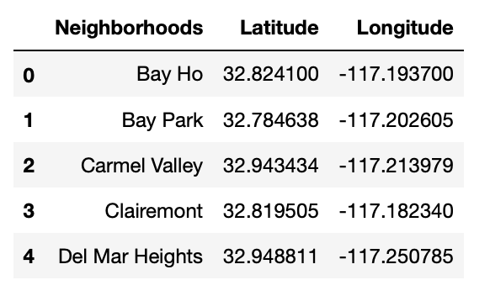
Data Analysis
Dataframe containing San Diego neighborhoods and geographical coordinates -- latitude and longitude of each neighborhood

Slide 9
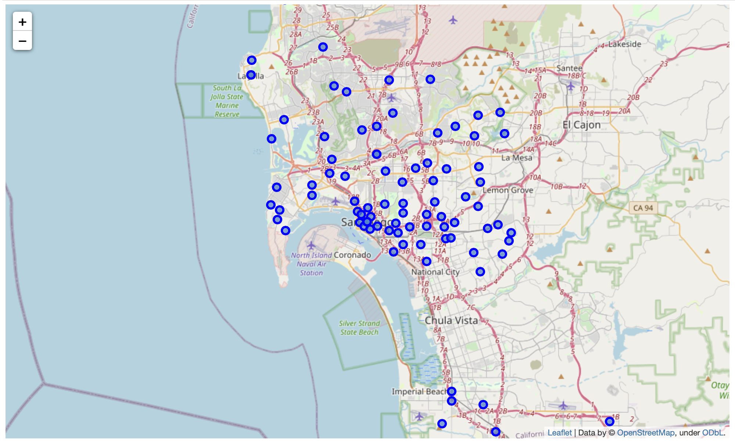
Map of San Diego using Folium
Map of San Diego with neighborhoods superimposed on top

Slide 10
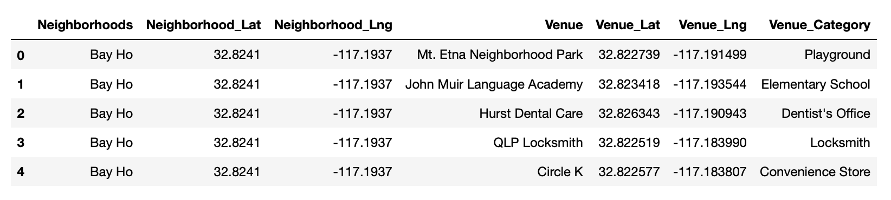
Explore San Diego Neighborhoods
Explore and segment San Diego neighborhoods using Foursquare API
Set the limit as 100 venue and the radius 1000 meter for each neighborhood from their given latitude and longitude value.
Number of venues returned by Foursquare : 10283
Number of unique venue category : 510
Below is the dataframe containing venues, venue categories, latitude, and longitude of each neighborhood returned by Foursquare:

Slide 11
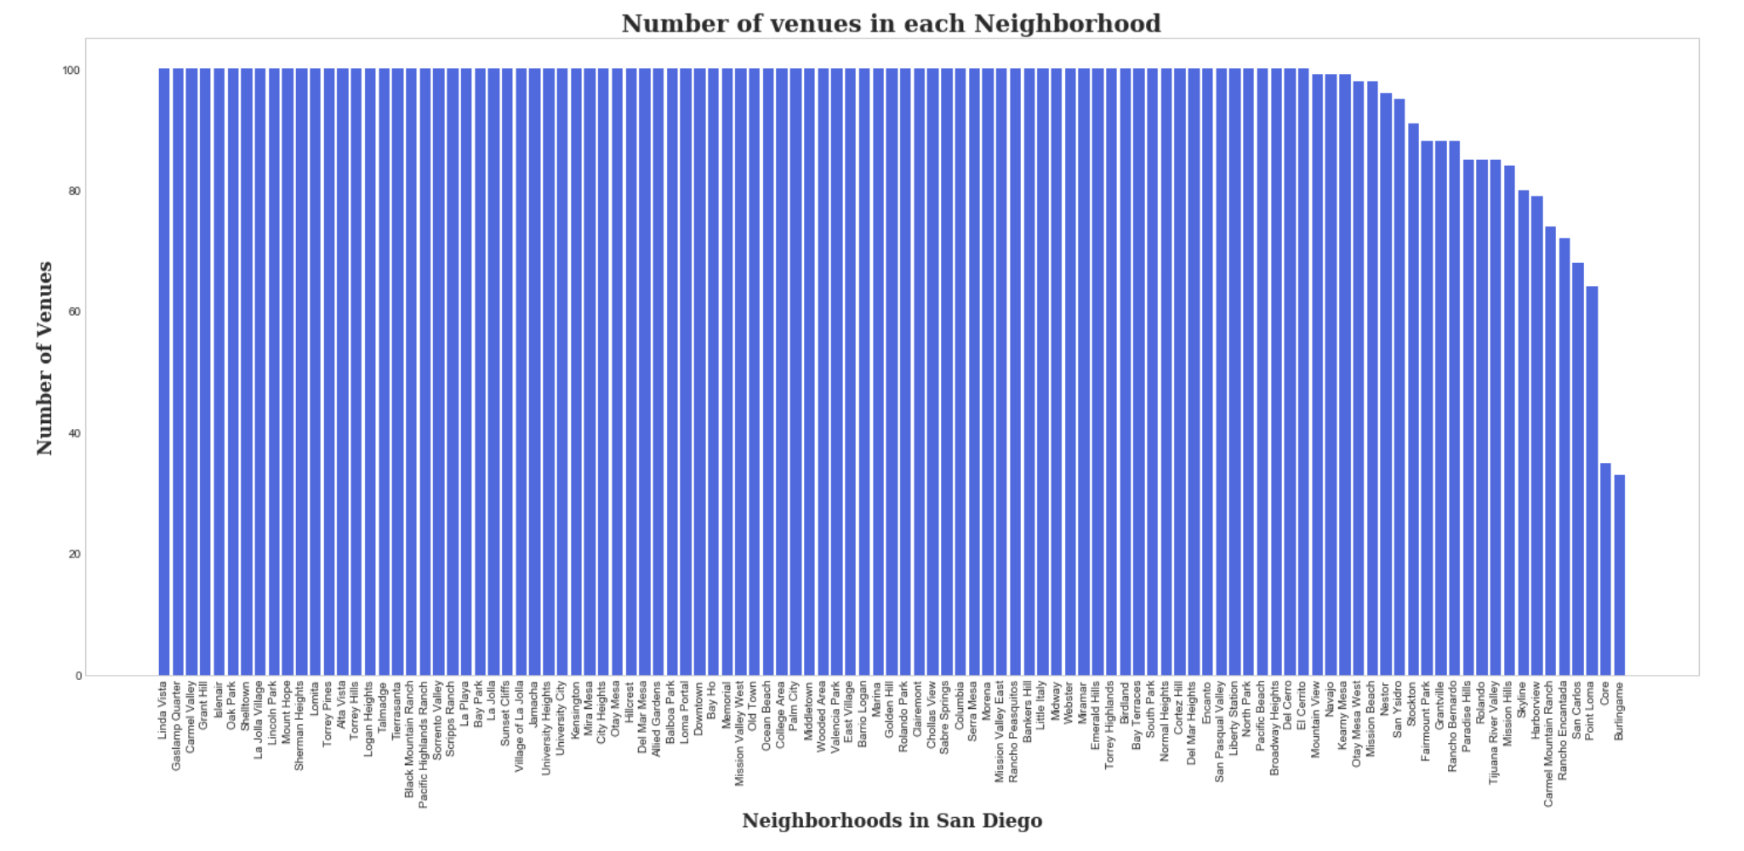
Number of Venues in each Neighborhood
Bar chart showing number of venues in each neighborhoods
Linda Vista, Serra Mesa, Mira Mesa, Torrey Pines, Hillcrest, Village of La Jolla, and many other neighborhoods have reached the 100 limit of venues. On the other hand, Burlingame and Core have less than 50 venues. Neighborhoods having 100 or more venues have been considered for the rest of the analysis.

Slide 12
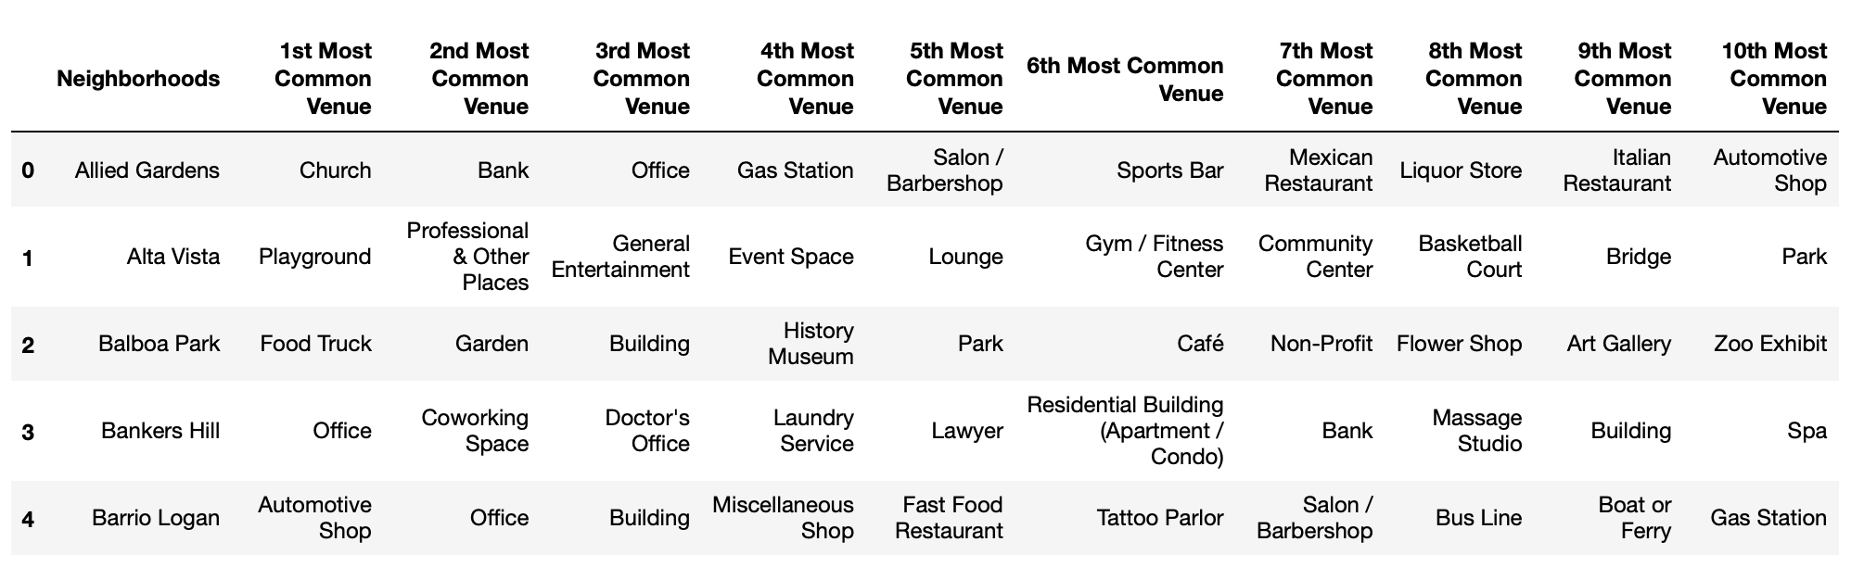
Analyze Each Neighborhood
Analyze each neighborhood having 100 or more venues
Number of neighborhoods having 100 or more venues: 84
No of unique venues: 491
Dataframe displaying the top 10 venues for each neighborhood:

Slide 13
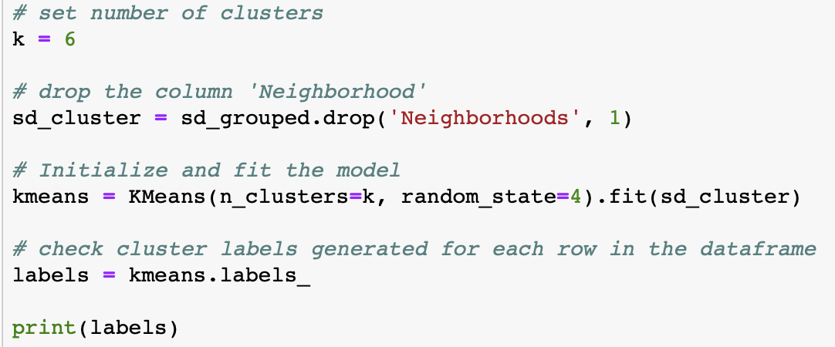
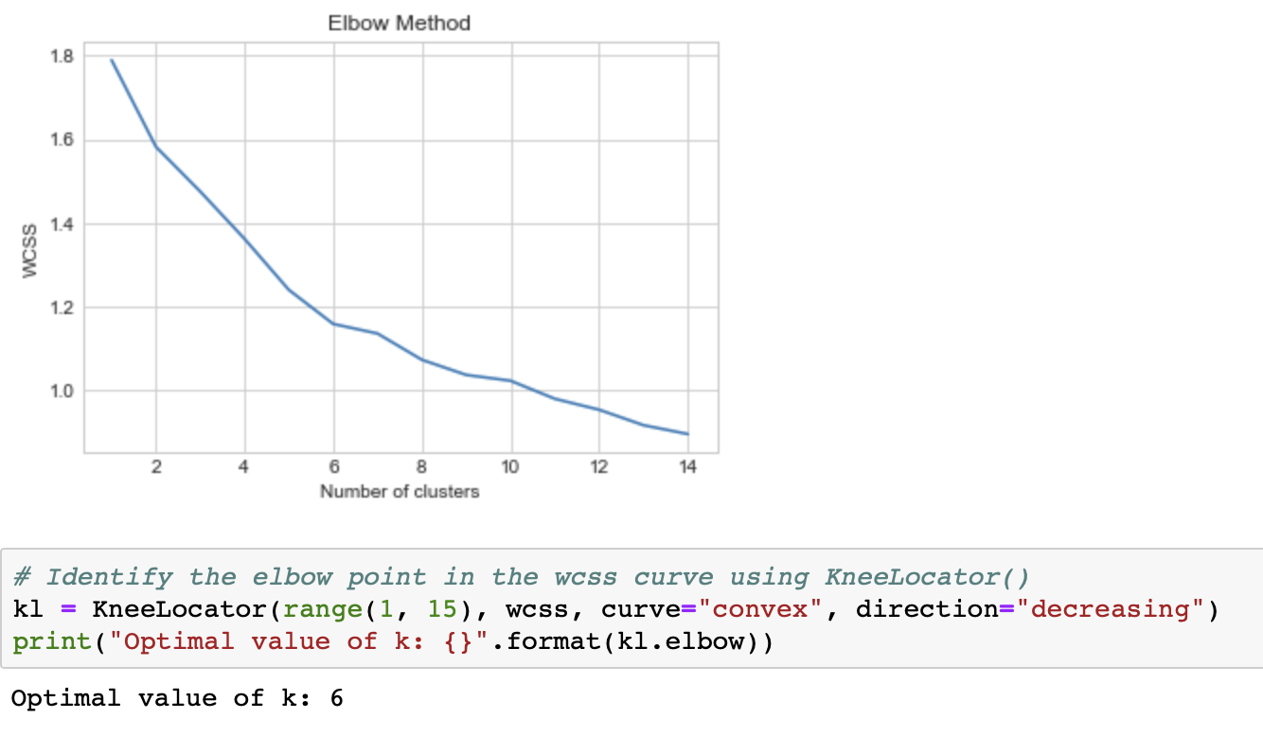
Modeling using K-means Clustering
Cluster Neighborhoods using K-means
Selecting the optimal value for k
The value of k is set to 6 (k=6) using the Elbow Method
which gives the value of k such that the total
within-cluster variation (or error) is minimum
Modeling using K-means Clustering

Slide 14
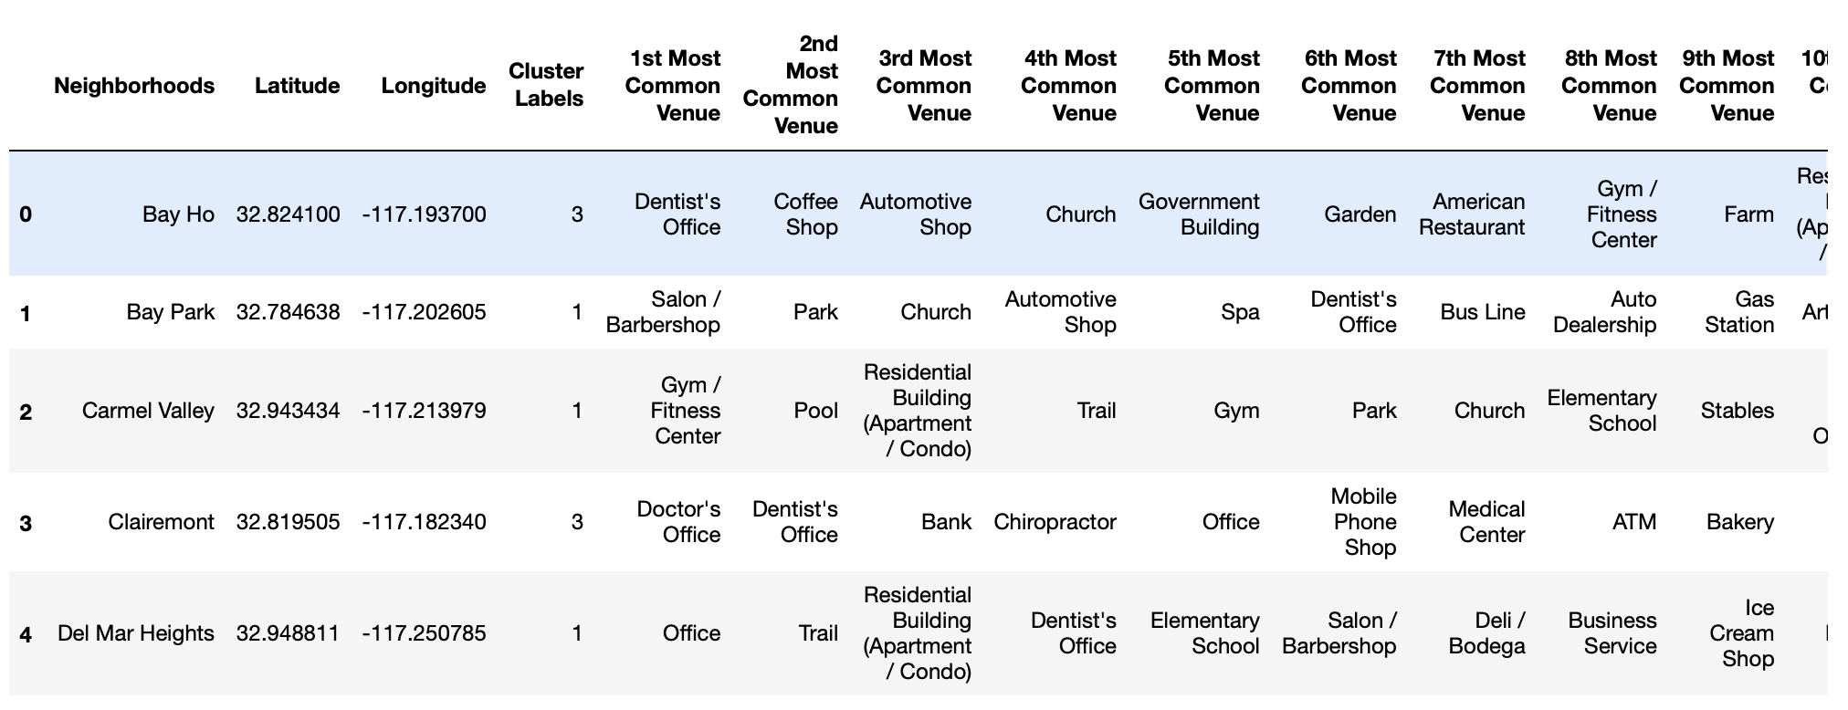
Modeling using K-means Clustering
Dataframe including cluster labels as well as the top 10 venues for each neighborhood

Slide 15
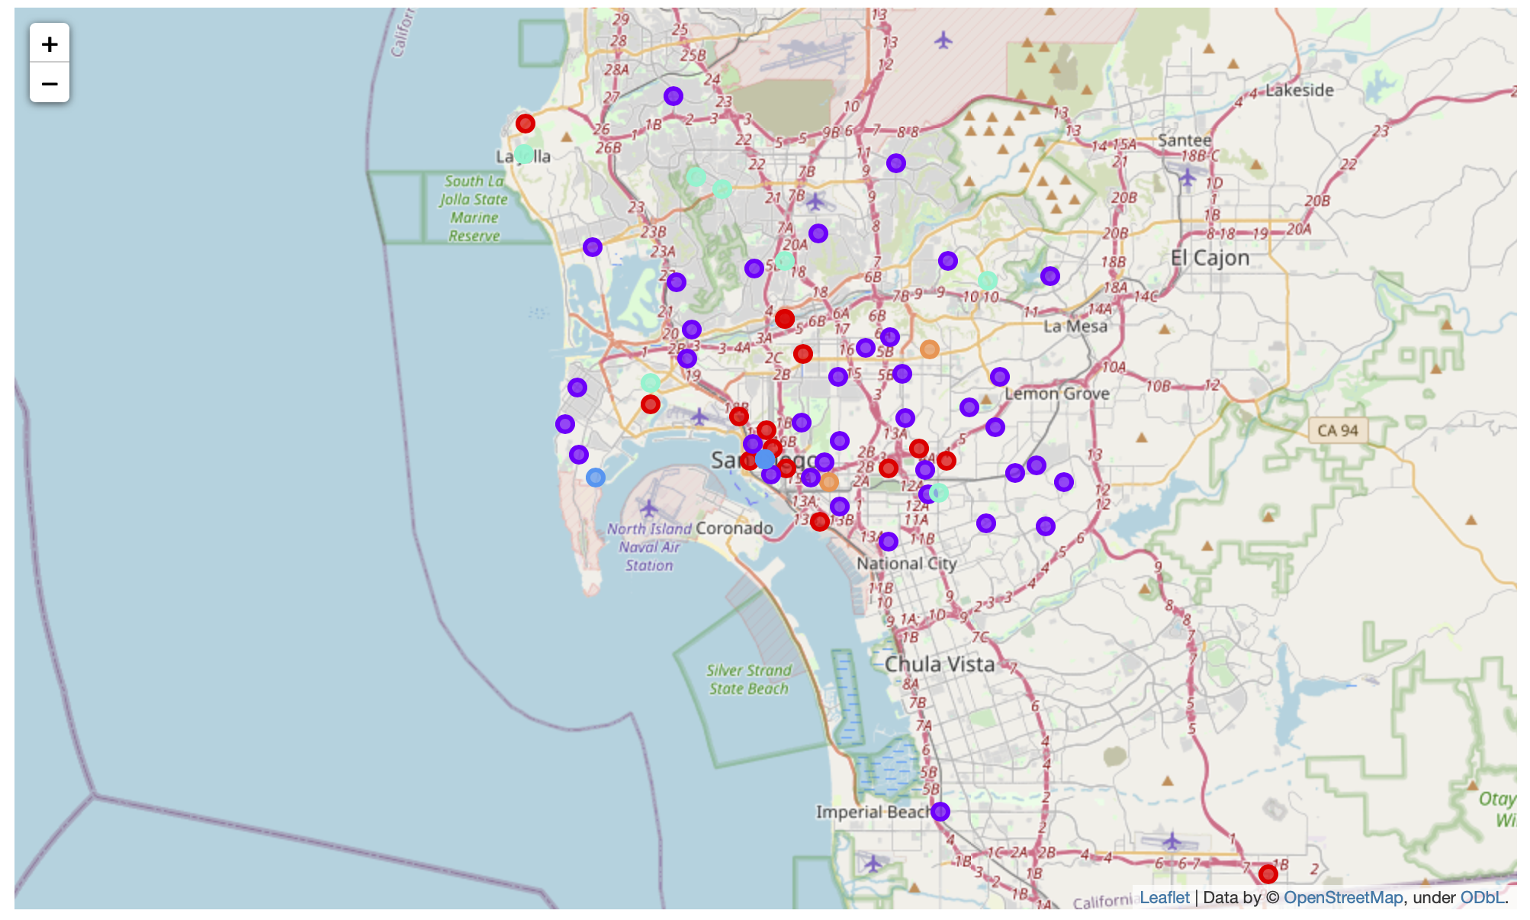
Modeling using K-means Clustering
Visualizing the resulting clusters

Slide 16
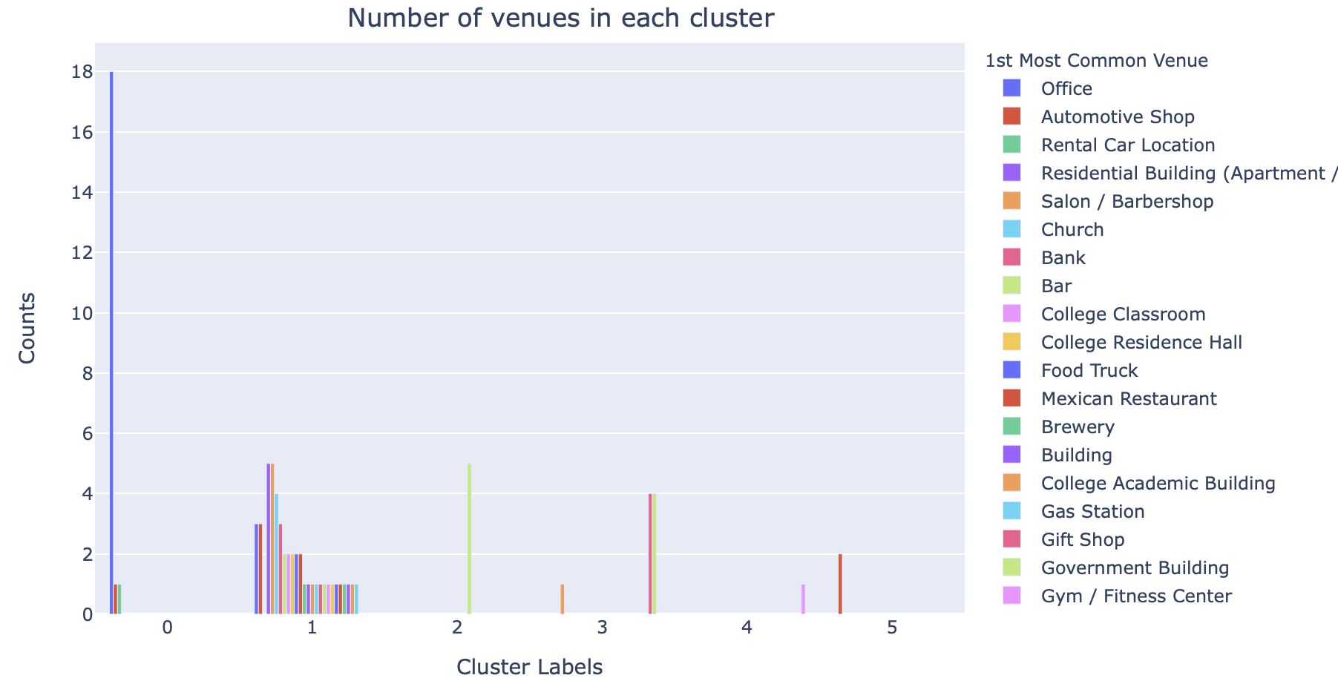
Explore Clusters
Exploring each Cluster
Bar chart showing number of 1st common venues in each Cluster
Cluster-0: offices and automotive shops
Cluster-1: Multiple Venues - residential buildings, college buildings, Salon, office, bank. restaurants
Cluster-2: Government buildings
Cluster-3: Doctor's and dentist's place
Cluster-4: Zoo exhibit
Cluster-5: Automotive shops
Cluster-0, Cluster-1, and Cluster-3 have been selected for further analysis to get the following information:
All the neighborhoods
Number and category of restaurants
Population base: Foot or car traffic
Parking
Demographical information such as population, housing, crime rate etc.

Slide 17
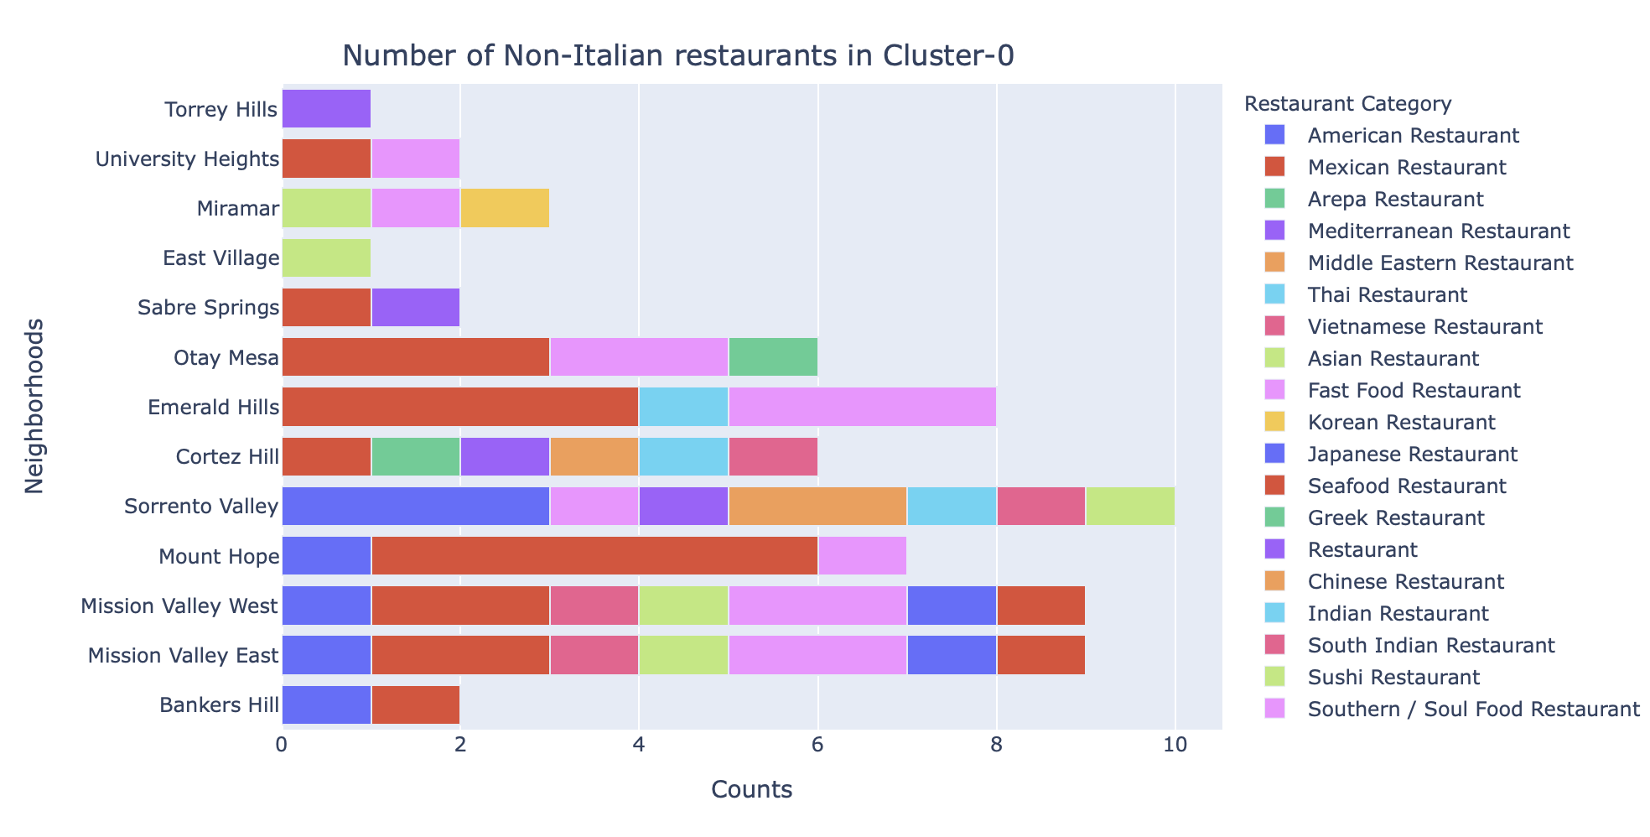
Cluster-0
Number of neighborhoods: 20
Total number of restaurants: 97
Unique restaurants: 22
Number of neighborhoods with no Italian restaurants: 13
Horizontal stack bar chart displaying number of non-Italian restaurants:
Selected neighborhoods having restaurants of 4 or more different categories:
Sorrento Valley
Mission Valley East
Mission Valley West
Cortez Hill

Slide 18
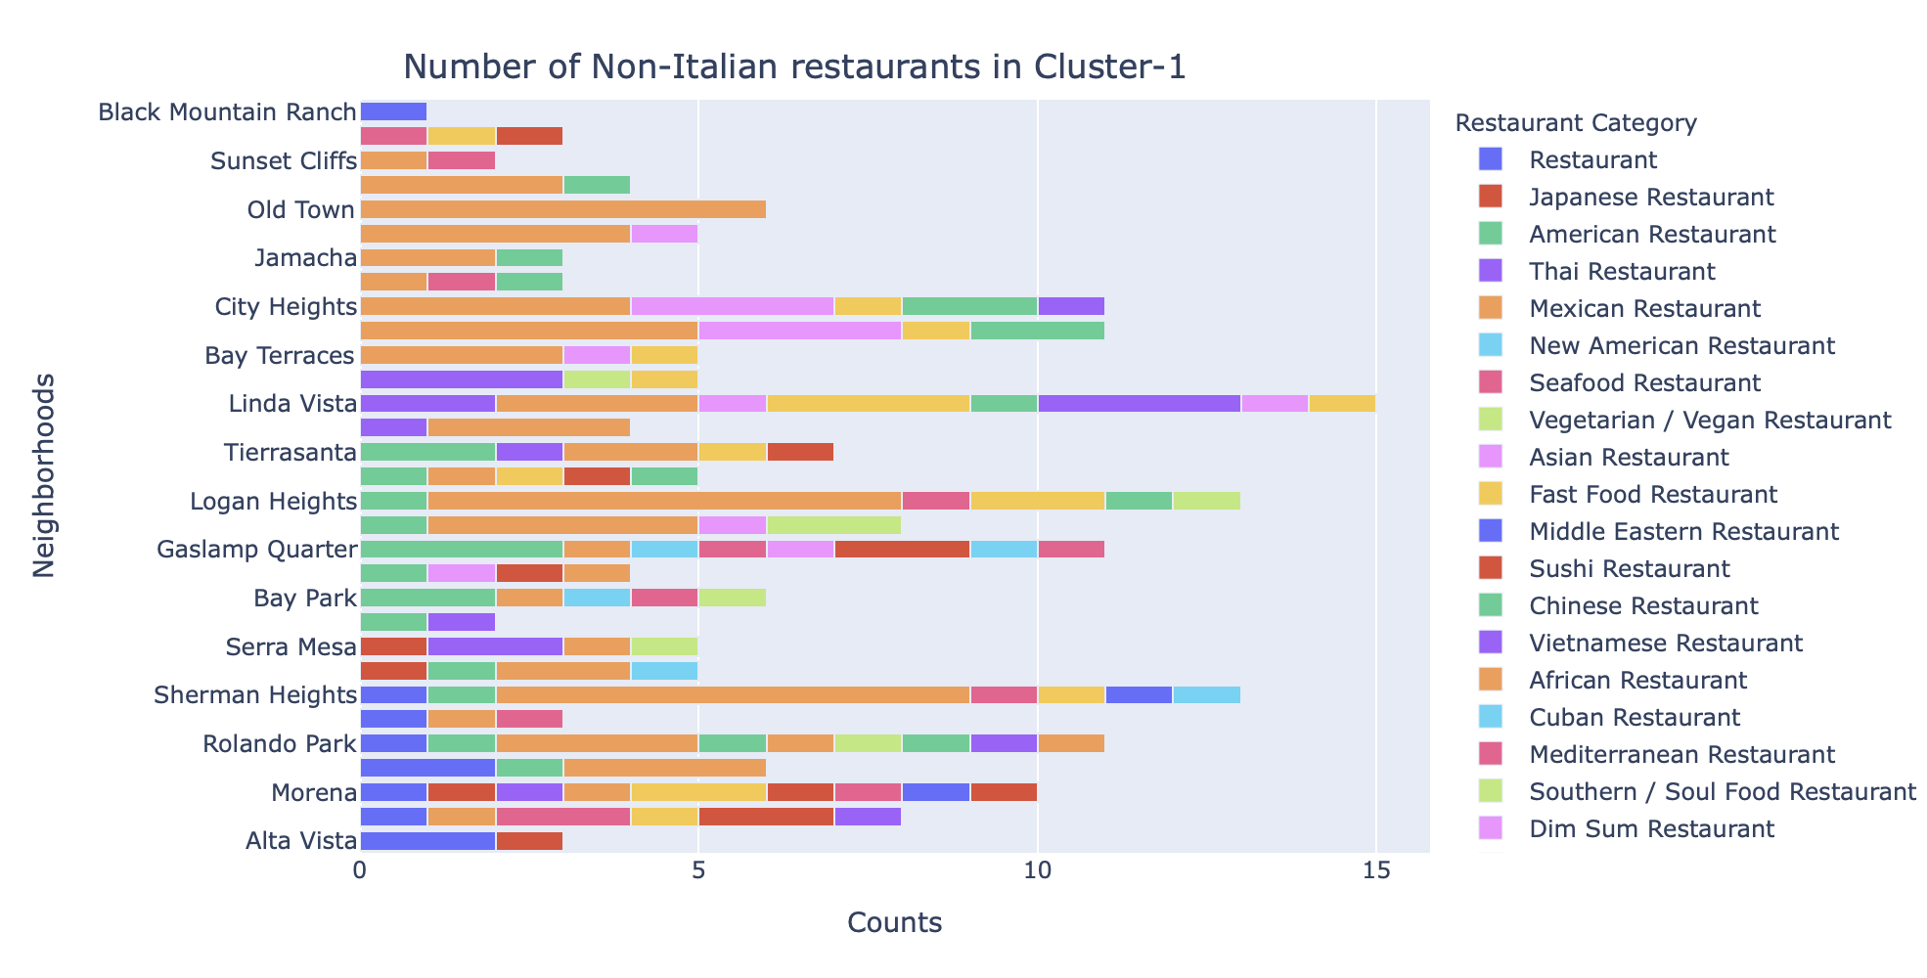
Cluster-1
Number of neighborhoods: 47
Total number of restaurants: 304
Unique restaurants: 33
Number of neighborhoods with no Italian restaurants: 31
Horizontal stack bar chart displaying number of non-Italian restaurants:
Selected neighborhoods having restaurants of 4 or more different categories:
Linda Vista
Logan Heights
Sherman Heights
Ronaldo Park
Gaslamp Quarter
City Heights
Chollas View
Morena
Del Mar Heights
Islenair
Serra Mesa
Del Mar Mesa
Rancho Penasquitos
Tierrasanta

Slide 19
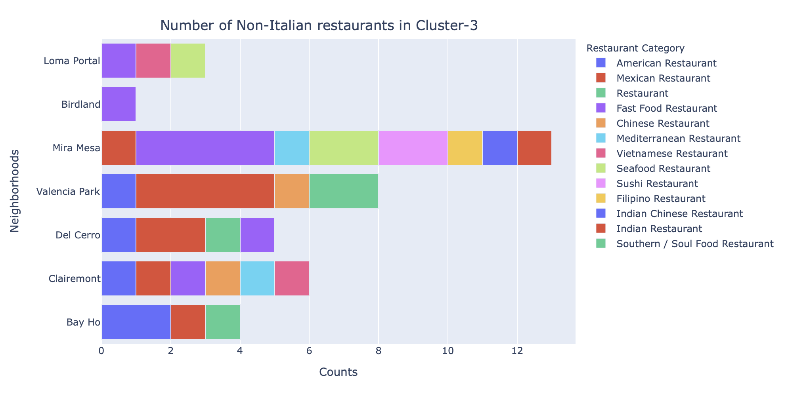
Cluster-3
Number of neighborhoods: 9
Total number of restaurants: 50
Unique restaurants: 15
Number of neighborhoods with no Italian restaurants: 7
Horizontal stack bar chart displaying number of non-Italian restaurants:
Selected neighborhoods having restaurants of 4 or more different categories:
Mira Mesa
Valencia Park
Clairemont
Del Cerro

Slide 20
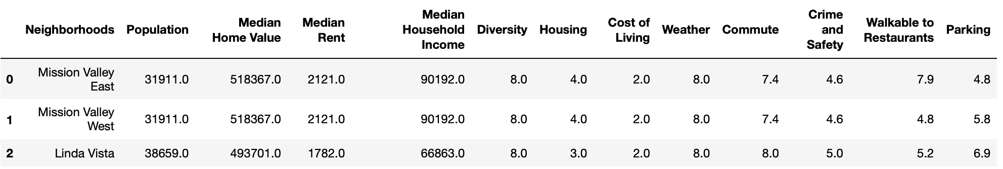
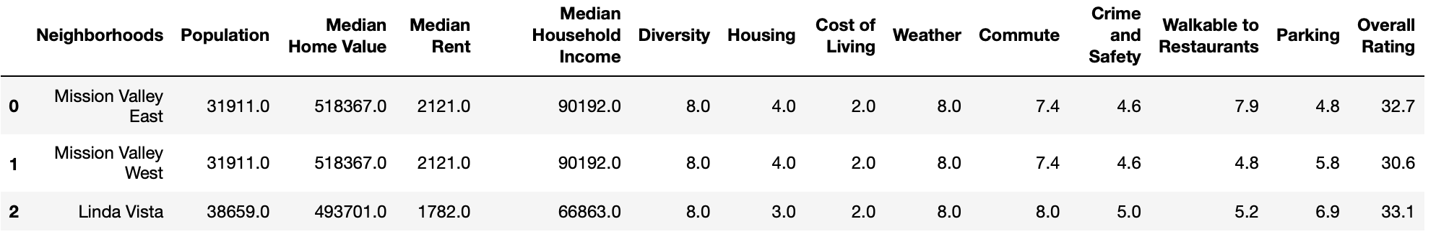
Merging Demographical Data with Clusters
Merging Demographical Data with Clusters
Dataframe with demographical data of San Diego
Dataframe with a new column Overall Rating after summing up the ratings of features – Diversity, Commute, Crime and Safety, Walkable to Restaurants, and Parking:

Slide 21
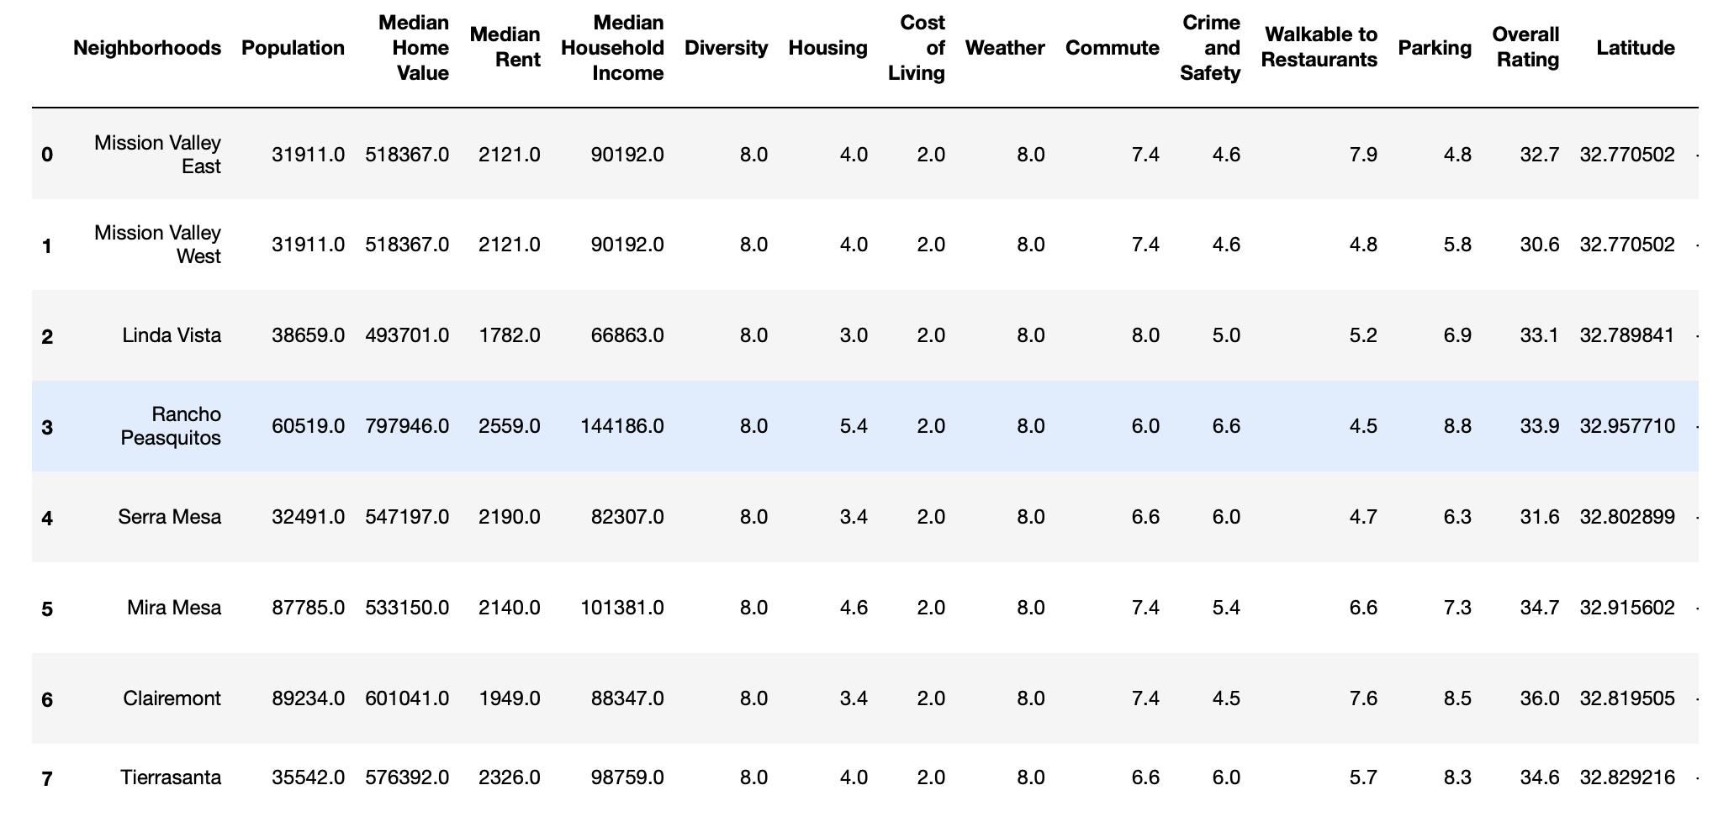
Merging Demographical Data with Clusters
Final dataframe after merging demographical data with clusters:

Slide 22
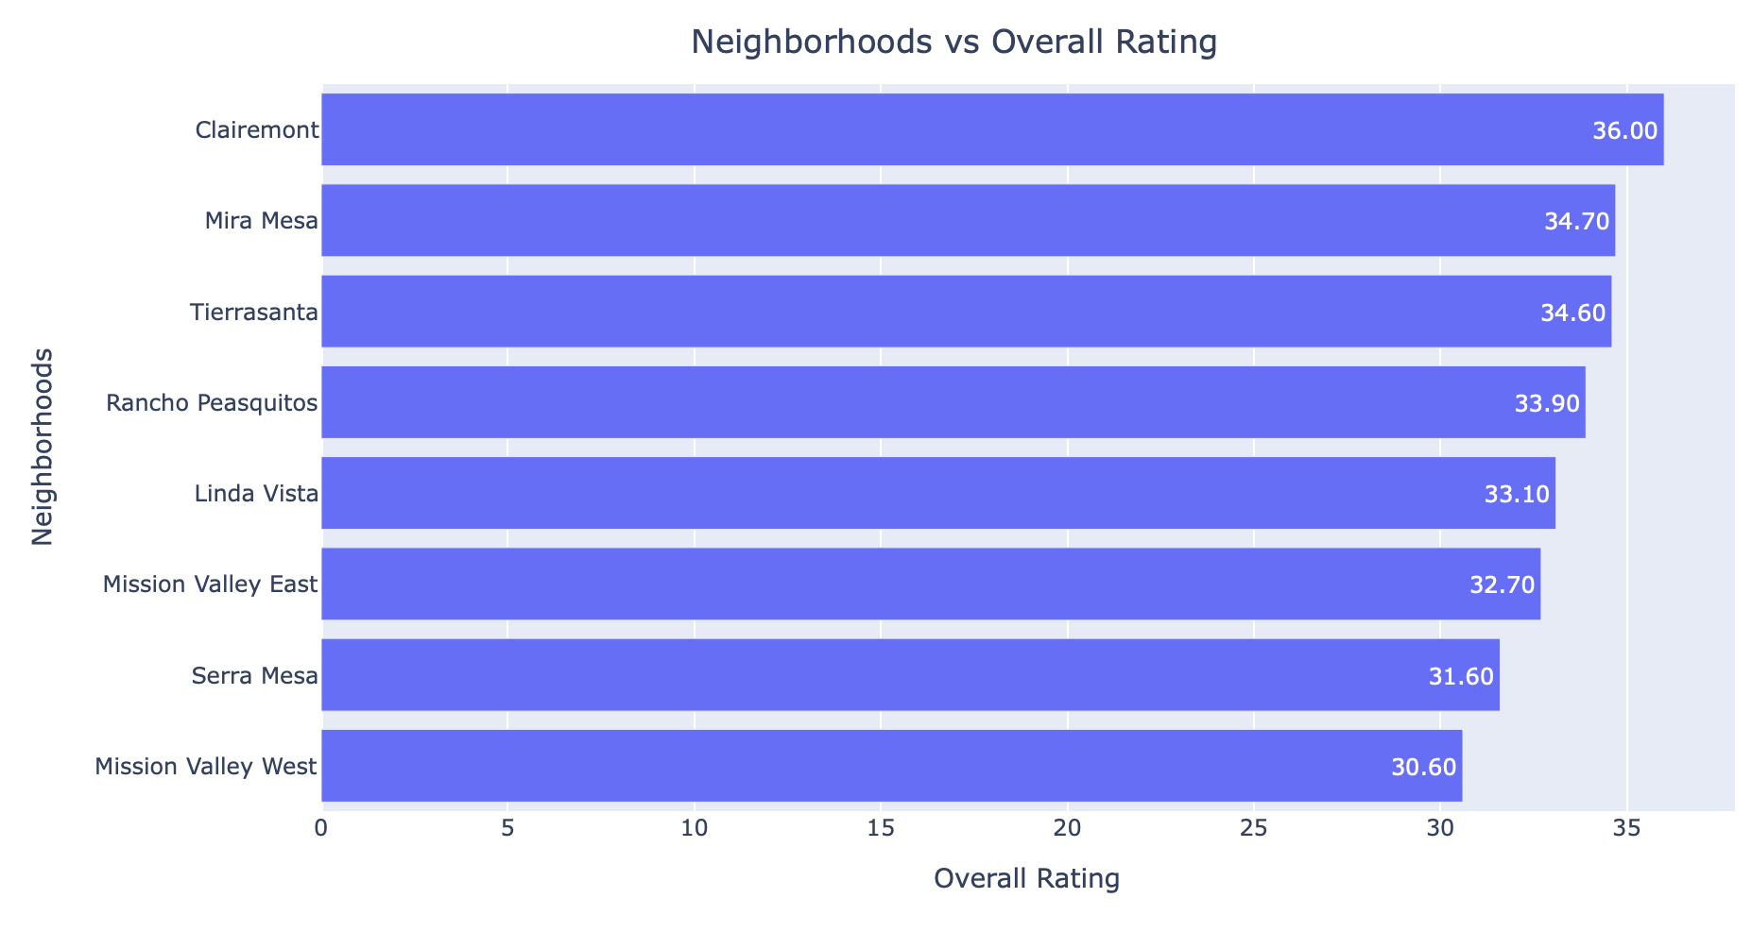
Results
List of the selected 8 Neighborhoods
Clairemont
Mira Mesa
Tierrasanta
Rancho Penasquitos
Linda Vista
Mission Valley East
Serra Mesa
Mission Valley West
Bar plot -- Neighborhoods vs. Overall Rating

Slide 23
Results
Final dataframe combining neighborhoods cluster data and demographical data

Slide 24
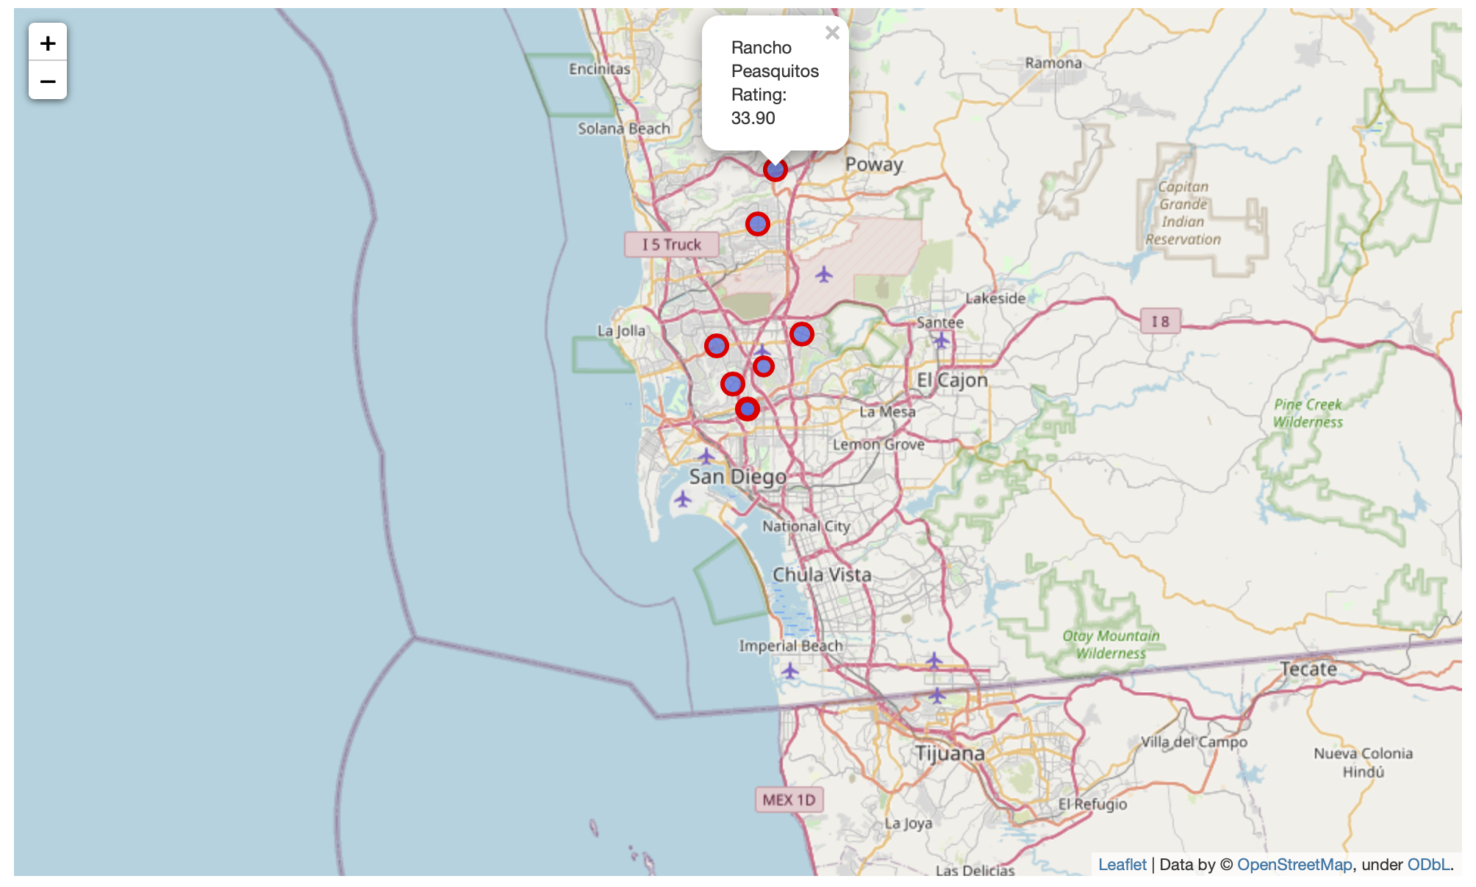
Results
Map of San Diego with the selected 8 neighborhoods superimposed on top

Slide 25
Discussion
Exploratory data analysis (EDA) and K-means clustering algorithm are used in order to discover a few precise locations for opening up an Italian restaurant.
For K-means cluster modeling, the optimal value of the k is set to 6 (k=6) using the Elbow Method.
Specific names have been assigned to the 6 clusters depending on the characteristics and different venues associated with these clusters.
Cluster-0, Cluster-1, and Cluster-3 have been selected for further analysis.
Following information have been derived using EDA:
Number of neighborhoods in Cluster-0, Cluster-1, Cluster-3 are 20, 47, and 9 respectively.
Total number of restaurants in Cluster-0, Cluster-1, Cluster-3 are 97, 304, and 50 respectively.
Number of unique restaurants category in Cluster-0, Cluster-1, Cluster-3 are 22, 33, and 15 respectively
Number of neighborhoods with no Italian restaurants in Cluster-0, Cluster-1, Cluster-3 are 13, 31, and 7 respectively.
Finally, following 8 neighborhoods have been selected based:
Clairemont
Mira Mesa
Tierrasanta
Rancho Penasquitos
Linda Vista
Mission Valley East
Serra Mesa
Mission Valley West

Slide 26
Conclusion
Objective of this project was to discover a few promising neighborhoods of San Diego with having no Italian restaurants in the vicinity so that the stakeholders -- more specifically, the restaurant entrepreneurs can select a optimal location for opening up a new Italian Restaurant.
By using Foursquare API, basic exploratory data analysis, and K-means clustering algorithm, some neighborhoods from three selected clusters have been identified. Then, these neighborhoods are explored to find out the locations which satisfy some basic requirements of this project. Finally, demographical information of San Diego has been merged with these selected neighborhoods to find more precise locations for an Italian restaurant.
Final decision on optimal restaurant location will be made by stakeholders based on specific characteristics and locations of these neighborhoods.

